Slide 1


A Multimodal Generative AI System for Skin Lesion Diagnosis and Explanation
Team Members: Aman Chauhan (22BCE0476) , Arnav Sinha (22BCE0830) , Akshat Sinha (22BCE2218)
Mentor Name:-Dr. Naga Priyadarsini R
School:- Scope Department
College:- Vellore Institute Of Technology , Vellore

Slide 2



Project Overview
Introduction to the Project
A critical task in dermatology is distinguishing between benign and malignant skin lesions, a process that traditionally combines visual dermoscopy with patient context (age, sex, lesion location). This project introduces a multimodal AI assistant to streamline this process.
Our system is designed to:
Analyze Multimodal Data: Processes both dermoscopic images and patient metadata to inform its diagnosis.
Provide Accurate Diagnosis: Classifies skin lesions to differentiate between malignant and benign conditions.
Generate Explanations: Produces a human-readable report that justifies its diagnostic findings, creating a more complete clinical tool.

Slide 3


Project Goals
Key Objectives
Develop a Robust Multimodal Diagnostic Model
Generate Intelligent Explanatory Reports
Ensure Accuracy Through Rigorous Validation
Integrate the diagnostic model with a large language model (LLM) to produce clinically relevant and easy-to-understand reports that explain the basis of the diagnosis.
Train and validate the system using large, publicly available datasets, specifically the International Skin Imaging Collaboration (ISIC) Archive, to guarantee high accuracy and generalizability.
Create a highly accurate diagnostic model that classifies skin lesions by effectively fusing visual information from dermoscopic images with textual clinical metadata.

Slide 4




Why This Matters
Motivation
Enhance Diagnostic Accuracy
Improve Clinical Workflow
Serve as a "second opinion" for dermatologists, reducing misdiagnosis rates.
Automate initial analysis and reporting, managing high patient loads.
Early Detection of Melanoma
Advance Medical AI
Provides a critical tool to support the early and accurate detection of melanoma, which is crucial for patient survival.
Combines discriminative and generative AI for a complete clinical tool.

Slide 5
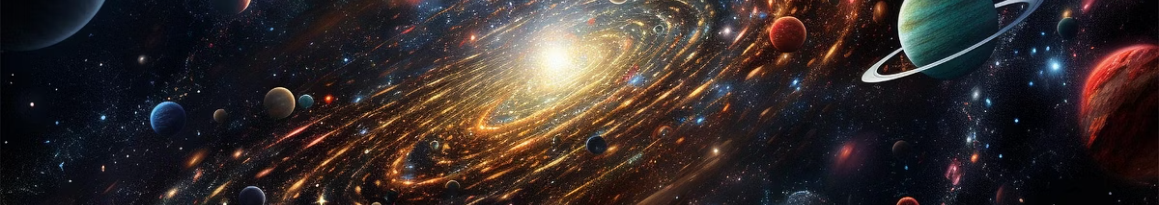
The Challenge
Problem Statement
How can a deep learning system effectively fuse visual information from dermoscopic images with textual clinical metadata (age, sex, lesion location) to not only accurately classify skin lesions but also to generate a coherent and clinically useful explanation for its prediction?
The clinical diagnosis of skin lesions, such as melanoma, relies on a multimodal assessment of both visual dermoscopic images and textual patient metadata. While standard AI can accurately classify such lesions , its adoption is often limited by its "black box" nature, which hinders clinical trust because the reasoning is unclear. Our project addresses this challenge by developing a system that not only accurately classifies lesions by fusing these diverse data types but also leverages generative AI to produce a coherent, human-readable report explaining

Slide 6
Our Approach
Proposed Methodology
Stage 1: Multimodal Diagnosis
1
Utilize ISIC 2019/2020 datasets. Process dermoscopic images with an Image Encoder (EfficientNet) and metadata (converted to natural language) with a Text Encoder (ClinicalBERT). Fuse the visual and textual embeddings to classify skin lesions.
2
Stage 2: Generative Explanation
Feed the diagnosis, confidence score, and clinical context from Stage 1 into a pre-trained Large Language Model (LLM) like GPT-4. Use Prompt Engineering to guide the LLM to generate a comprehensive diagnostic report, including the final diagnosis, justification, potential differential diagnoses, and next steps.

Slide 7

System Blueprint
Multimodal AI Architecture
Inputs
Stage 2: Generative Engine
Dermoscopic Image
Structured Diagnosis + Clinical Context → Prompt Engineering Module → Detailed Prompt
Clinical Metadata (Age, Sex, Location) → Encoded Text
Detailed Prompt → Large Language Model (GPT-4) → Generated Diagnostic Report
Stage 1: Diagnostic Engine
Image Encoder (EfficientNet CNN) → Visual Embedding
Final Output
Text Encoder (ClinicalBERT) → Textual Embedding
Multimodal Fusion (Concatenation) → Fused Representation
Comprehensive Diagnostic Report (Human-readable)
Diagnostic Classifier (Dense Layer with Softmax) → Structured Diagnosis (Class Probabilities)

Slide 8
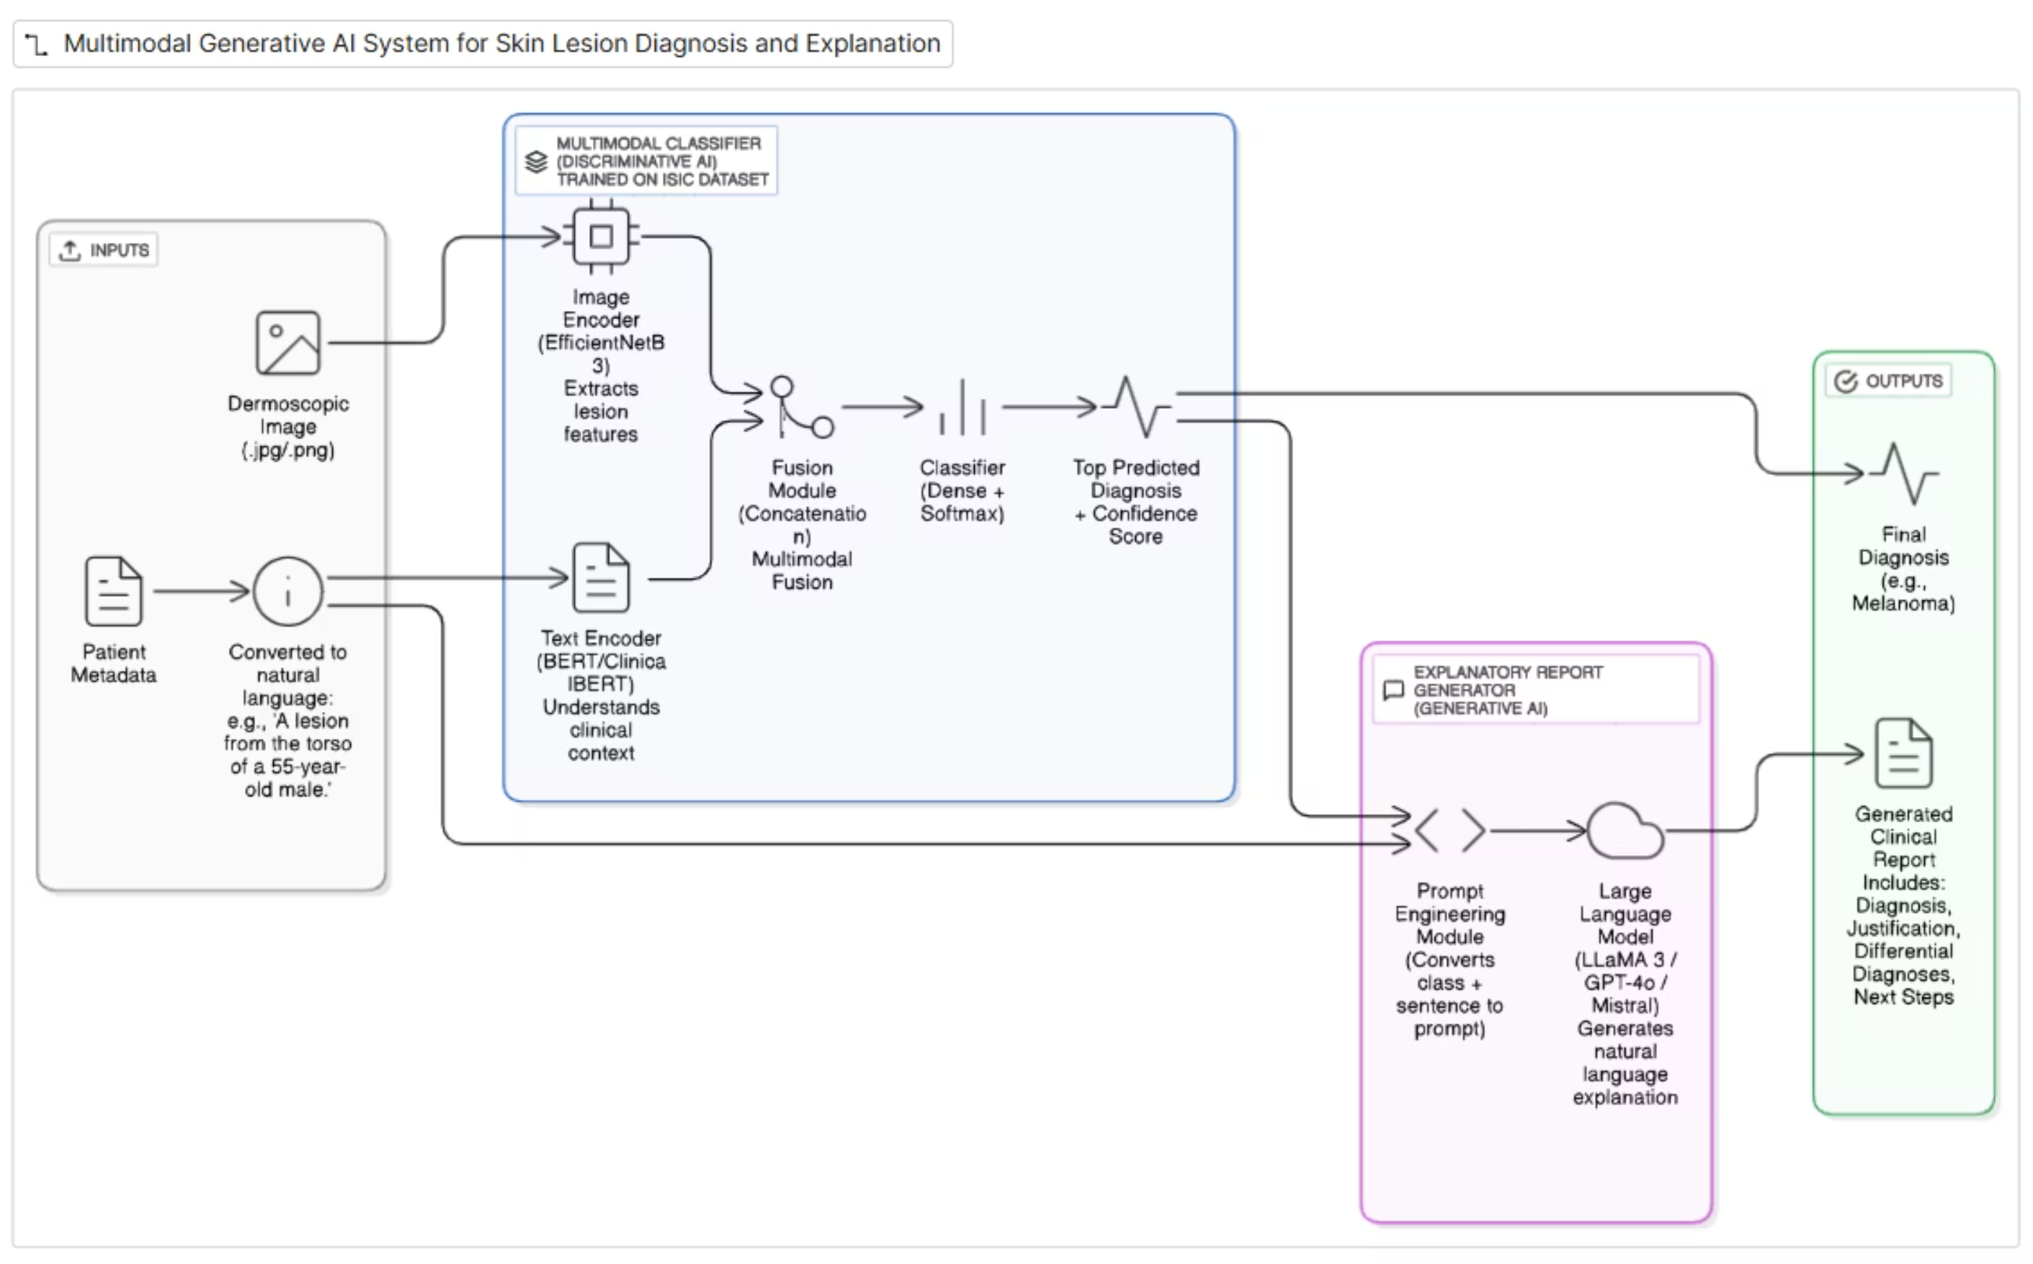
http://app.eraser.io/workspace/L4xCP28PQmhFsdeDAiiW

Slide 9
Model Selection
Image Encoder
The role of the Image Encoder is to analyze the dermoscopic image and extract its important visual features. We will use pre-trained models, which is highly recommended for such tasks.
Recommended Starting Point: EfficientNetB3
A highly effective CNN that provides a fantastic balance between accuracy and manageable size for a student project. It is a modern and popular choice for image classification tasks.
Advanced Alternative: Swin Transformer
A state-of-the-art Vision Transformer architecture that is often more efficient and powerful than standard transformers. This model architecture was explicitly used for image processing in one of the provided research papers, making it a highly relevant and advanced choice for this project.
Reliable Baseline: ResNet50
A classic and powerful CNN that is very robust. It serves as a great model for establishing a reliable baseline performance for our image classification task.
Availability: All these models are available pre-trained in standard deep learning libraries such as PyTorch (torchvision) and TensorFlow (Keras).

Slide 10
Model Selection (Cont.)
Text Encoder & LLM
Text Encoder
Large Language Model (LLM)
To understand clinical metadata:
To generate the final report:
Recommended: BERT (bert-base-uncased).
Open-Source: Llama 3 (8B-Instruct) or Mistral (7B-Instruct).
Advanced: ClinicalBERT (pre-trained on medical notes).
Availability: Hugging Face Hub (transformers library).
API-based: OpenAI's GPT-4o or Google's Gemini.
Availability: Hugging Face Hub (open-source), company websites (APIs).
Fusion Module & Classifier
Fusion: Concatenation (code yourself).
Classifier: Linear/Dense layer with Softmax activation.

Slide 11
Fusion Module & Classifier: Combining Data for Prediction
Fusion Module
Technique: We will use Concatenation.
Description: This is the simplest and most common method for combining the information from the image and text encoders. It is a technique that we will code ourselves.
Process: The feature vector from the image encoder and the feature vector from the text encoder are joined end-to-end to create a single, long multimodal vector.
Classifier Layer
Model/Layer: The final prediction is made using a standard Linear layer (in PyTorch) or Dense layer (in TensorFlow).
Activation Function: A Softmax activation function is applied to the output of this layer.
This converts the model's raw output into a list of probabilities for each disease class (e.g., [Melanoma: 91%, Nevus: 5%, ...]).

Slide 12
Demonstrating Impact
Unique Contributions & Experiments
Encoder Showdown
1
Compare CNN vs. Vision Transformer image encoders for accuracy.
Domain-Specific Knowledge Test
2
Evaluate general BERT vs. specialised ClinicalBERT performance.
Ablation Study
3
Prove multimodal approach superiority over single-modality models.
Cross-Dataset Generalisation
4
Test model robustness on unseen datasets (e.g., ISIC 2018).
Generative Report Quality Analysis
5
Assess LLM output for clinical relevance and keyword inclusion.

Slide 13
References(Links):-
Primary Datasets: The ISIC (International Skin Imaging Collaboration) Archive. This is not a single dataset but a collection from yearly challenges. ○ ISIC 2020: Contains over 33,000 images and metadata. Focuses on melanoma detection.
■ Link: https://challenge2020.isic-archive.com/ ○ ISIC 2019: Contains over 25,000 images with 8 diagnostic categories.
■ Link: https://challenge2019.isic-archive.com/ ○ ISIC 2018: Contains 10,000 images for lesion classification into 7 categories.
■ Link: https://challenge2018.isic-archive.com/ https://www.kaggle.com/datasets/kmader/skin-cancer-mnist-ham10000/code https://www.kaggle.com/code/sujitmishra64/melanoma-detection https://www.kaggle.com/datasets/fanconic/skin-cancer-malignant-vs-benign/code
ISIC Archive Main Page: https://www.isic-archive.com/ ■ 2020 Challenge Dataset (A great starting point): https://challenge2020.isic-archive.com/ ■ https://openi.nlm.nih.gov/

